Slide 1
Modern Systems Analysis and Design Jeffrey A. Hoffer Joey F. George Joseph S. Valacich
Chapter 10
Designing Databases

Slide 2
Learning Objectives
Define key database design terms.
Explain the role of database design in the IS development process.
Transform E-R or class diagrams into normalized relations.
Merge normalized relations from separate user views into a consolidated set of well-structured relations.
Choose storage formats for fields.
Translate well-structured relations into database tables.
Explain when to use different types of file organizations.
Describe the purpose and appropriate use of indexes.

Slide 3
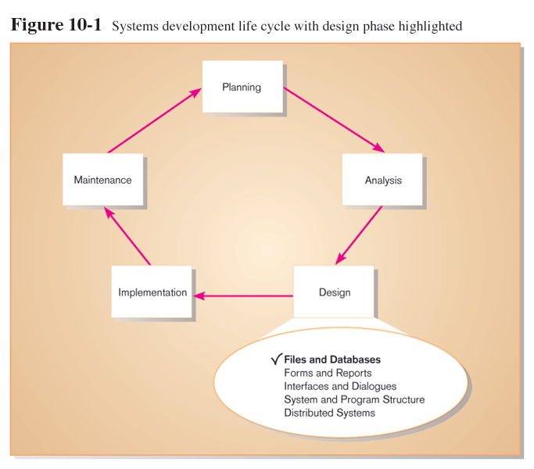

Slide 4
Logical Database Design
Based upon the conceptual data model
Four key steps
Develop a logical data model for each known user interface for the application using normalization principles.
Combine normalized data requirements from all user interfaces into one consolidated logical database model (view integration).
Translate the conceptual E-R data model for the application into normalized data requirements.
Compare the consolidated logical database design with the translated E-R model and produce one final logical database model for the application.

Slide 5
Physical Database Design
Based upon results of logical database design
Key decisions
Choosing storage format for each attribute from the logical database model
Grouping attributes from the logical database model into physical records
Arranging related records in secondary memory (hard disks and magnetic tapes) so that records can be stored, retrieved and updated rapidly
Selecting media and structures for storing data to make access more efficient

Slide 6
Deliverables and Outcomes
Logical database design
must account for every data element on a system input or output
normalized relations are the primary deliverable
Physical database design
converting relations into database tables

Slide 7
Relational Database Model
Relational Database: data represented as a set of related tables (or relations)
Relation: a named, two-dimensional table of data. Each relation consists of a set of named columns and an arbitrary number of unnamed rows
Well-Structured Relation: a relation that contains a minimum amount of redundancy and allows users to insert, modify, and delete the rows without errors or inconsistencies

Slide 8
Properties of a Relation
Entries in cells are simple.
Entries in columns are from the same set of values.
Each row is unique.
The sequence of columns can be interchanged without changing the meaning or use of the relation.
The rows may be interchanged or stored in any sequence.

Slide 9
Primary Keys
Primary Key
An attribute whose value is unique across all occurrences of a relation.
All relations have a primary key.
This is how rows are ensured to be unique.
A primary key may involve a single attribute or be composed of multiple attributes.

Slide 10
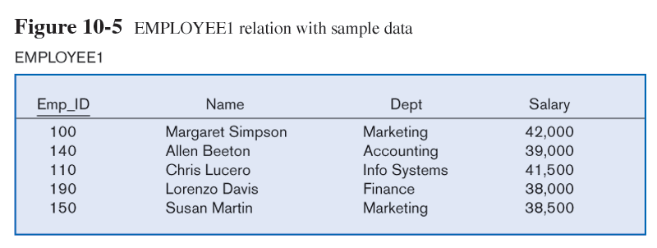
Well-Structured Relation
No redundancy, and data pertains to a single entity, an employee

Slide 11
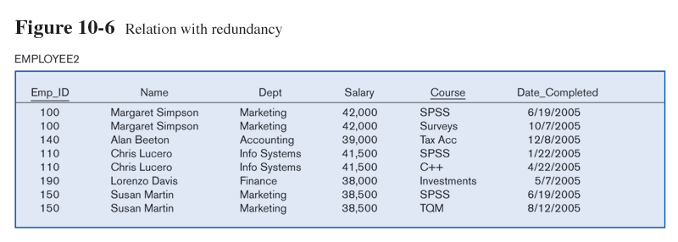
A Poorly Structured Relation
Redundancies, because data pertains to a two entities, employees and the courses they take

Slide 12
Normalization
The process of converting complex data structures into simple, stable data structures
First Normal From (1NF)
Unique rows
No multivalued attributes
All relations are in 1NF

Slide 13
Normalization (cont.)
Second Normal Form (2NF)
Each nonprimary key attribute is identified by the whole key (called full functional dependency).
Third Normal Form (3NF)
Nonprimary key attributes do not depend on each other (i.e. no transitive dependencies).
The result of normalization is that every nonprimary key attribute depends upon the whole primary key.

Slide 14
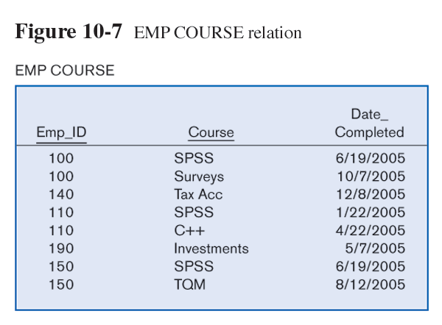
Normalized Relations
Redundancies removed by breaking into two separate relations

Slide 15
Functional Dependencies and Determinants
Functional Dependency
A particular relationship between two attributes. For a given relation, attribute B is functionally dependent on attribute A is, for every valid value of A, that value of A uniquely determines the value of B
Determinant: an attribute that determines the values of other attributes
All primary keys are determinants
Symbolic notation:
A → B
A is the determinant
B is functionally dependent on A

Slide 16
Identifying Functional Dependencies and Determinants
Functional dependency is not a mathematical dependency.
Instances (or sample data) in a relation do not prove the existence of a functional dependency.
Knowledge of problem domain is most reliable method for identifying functional dependency.

Slide 17
Second Normal Form (2NF)
A relation is in second normal form (2NF) if any of the following conditions apply:
The primary key consists of only one attribute
Every nonprimary key attribute is functionally dependent on the full set of primary key attributes

Slide 18
Conversion to a Higher Normal Form
To convert a relation into 2NF or 3NF, decompose the relation into new relations using the attributes, called determinants, that determine other attributes.
The determinants become the primary key of the new relation.

Slide 19
1NF but not 2NF
EMPLOYEE2(Emp_ID, Name, Dept, Salary, Course, Date_Completed)
Functional dependencies:
Emp_ID → Name, Dept, Salary partial key dependency
Emp_ID, Course → Date_Completed

Slide 20
2NF (actually, also 3NF)
EMPLOYEE1(Emp_ID, Name, Dept, Salary)
Functional dependencies:
Emp_ID → Customer_Name, SalesPerson
EMPCOURSE(Emp_ID, Course, Date_Completed)
Functional dependency:
Emp_ID, Course → Date_Completed

Slide 21
Third Normal Form (3NF)
A relation is in third normal form (3NF) if it is in second normal form (2NF) and there are no functional (transitive) dependencies between two (or more) nonprimary key attributes.

Slide 22
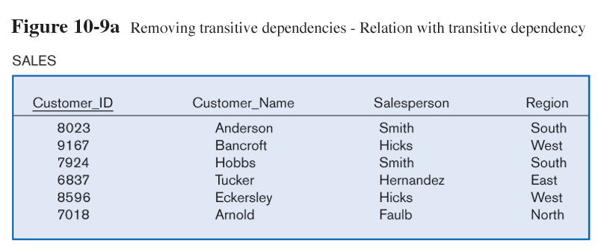
2NF but not 3NF
SALES(Customer_ID, Customer_Name, SalesPerson, Region)
Functional dependencies:
Customer_ID → Customer_Name, SalesPerson, Region
SalesPerson → Region
transitive

Slide 23
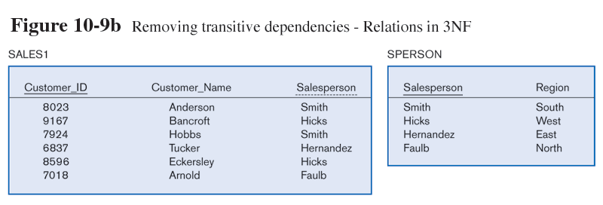
Converted to 3NF
SALES1(Customer_ID, Customer_Name, SalesPerson)
Functional dependencies:
Customer_ID → Customer_Name, SalesPerson
SPERSON(SalesPerson, Region)
Functional dependency:
SalesPerson → Region

Slide 24
Functional Dependencies and Primary Keys
Foreign Key
An attribute that appears as a nonprimary key attribute in one relation and as a primary key attribute (or part of a primary key) in another relation
Referential Integrity
An integrity constraint specifying that the value (or existence) of an attribute in one relation depends on the value (or existence) of the same attribute in another relation

Slide 25
Foreign Key Example
The foreign key
The foreign key establishes a one-to-many relationship between SPERSON (one) and SALES1 (many)
There can be no SalesPerson value in SALES1 that does not exist in SPERSON (referential integrity)

Slide 26
Transforming E-R Diagrams into Relations
It is useful to transform the conceptual data model into a set of normalized relations
Steps
Represent entities
Represent relationships
Normalize the relations
Merge the relations

Slide 27
Representing Entities
Each regular entity is transformed into a relation.
The identifier of the entity type becomes the primary key of the corresponding relation.
The primary key must satisfy the following two conditions.
The value of the key must uniquely identify every row in the relation.
The key should be nonredundant.

Slide 28
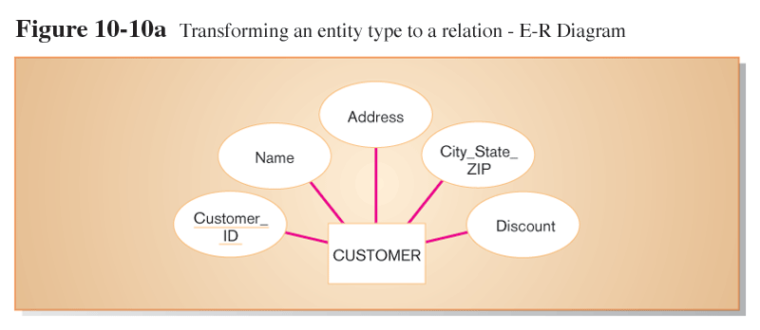

Slide 29
Represent Relationships
Binary 1:N Relationships
Add the primary key attribute (or attributes) of the entity on the one side of the relationship as a foreign key in the relation on the right side.
The one side migrates to the many side.
Binary or Unary 1:1
Three possible options
Add the primary key of A as a foreign key of B.
Add the primary key of B as a foreign key of A.
Both of the above.

Slide 30
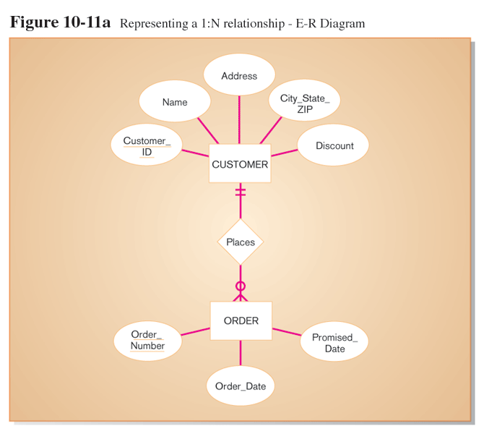
Represent Relationships (cont.)

Slide 31
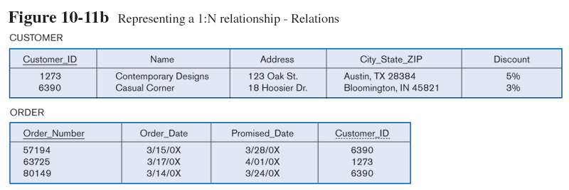
Represent Relationships (cont.)

Slide 32
Represent Relationships (cont.)
Binary and Higher M:N relationships
Create another relation and include primary keys of all relations as primary key of new relation.

Slide 33
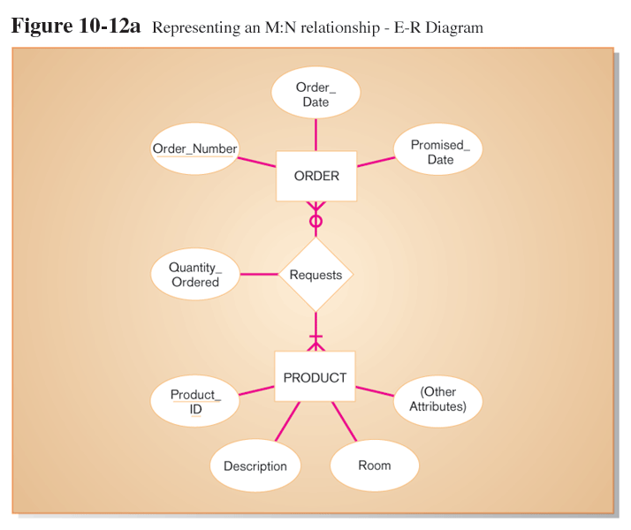
Represent Relationships (cont.)

Slide 34
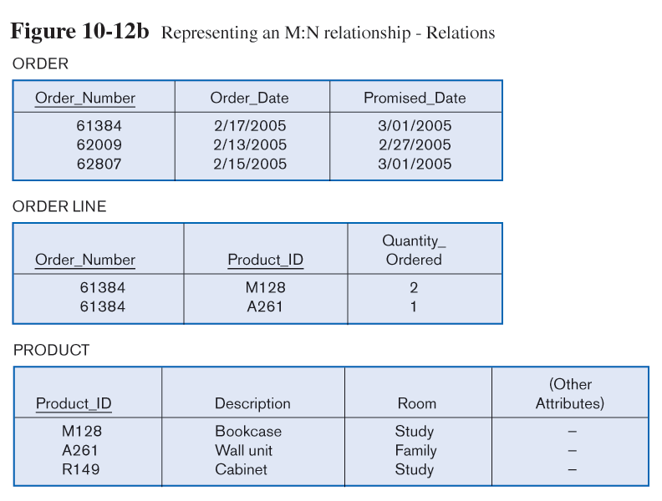
Represent Relationships (cont.)

Slide 35
Represent Relationships (cont.)
Unary 1:N Relationships
Relationship between instances of a single entity type
Utilize a recursive foreign key
A foreign key in a relation that references the primary key values of that same relation.
Unary M:N Relationships
Create a separate relation.
Primary key of new relation is a composite of two attributes that both take their values from the same primary key.

Slide 36
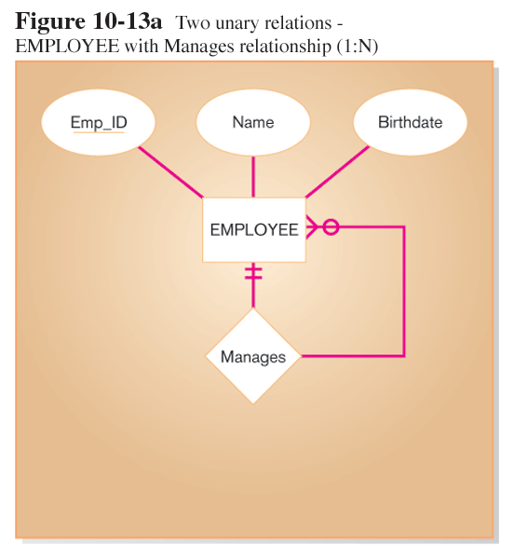
EMPLOYEE(Emp_ID, Name, Birthdate, Manager_ID)

Slide 37
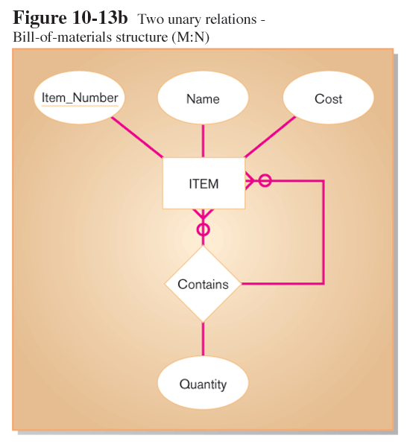
ITEM(Item_Number, Name, Cost)
ITEMCOMPONENT(Item_Number, Component_Number, Quatity)

Slide 38
Merging Relations (View Integration)
Purpose is to remove redundant relations
View Integration Problems
Synonyms
Two different names used for the same attribute
When merging, get agreement from users on a single, standard name
Homonyms
A single attribute name that is used for two or more different attributes
Resolved by creating a new name
Dependencies between nonkeys
Dependencies may be created as a result of view integration
In order to resolve, the new relation must be normalized

Slide 39
Physical File and Database Design
The following information is required:
Normalized relations, including volume estimates
Definitions of each attribute
Descriptions of where and when data are used, entered, retrieved, deleted, and updated (including frequencies)
Expectations or requirements for response time and data integrity
Descriptions of the technologies used for implementing the files and database

Slide 40
Designing Fields
Field
Smallest unit of named application data recognized by system software
Attributes from relations will be represented as fields
Data Type
A coding scheme recognized by system software for representing organizational data
Choosing data types
Four objectives
Minimize storage space
Represent all possible values of the field
Improve data integrity of the field
Support all data manipulations desired on the field
Calculated fields
A field that can be derived from other database fields

Slide 41
Methods of Controlling Data Integrity
Default Value
A value a field will assume unless an explicit value is entered for that field
Range Control
Limits range of values that can be entered into field
Referential Integrity
An integrity constraint specifying that the value (or existence) of an attribute in one relation depends on the value (or existence) of the same attribute in another relation
Null Value
A special field value, distinct from 0, blank, or any other value, that indicates that the value for the field is missing or otherwise unknown

Slide 43
Designing Physical Tables
Relational database is a set of related tables
Physical Table
A named set of rows and columns that specifies the fields in each row of the table
Design Goals
Efficient use of secondary storage (disk space)
Disks are divided into units that can be read in one machine operation.
Space is used most efficiently when the physical length of a table row divides close to evenly with storage unit.
Efficient data processing
Data are most efficiently processed when stored next to each other in secondary memory.

Slide 44
Denormalization
The process of splitting or combining normalized relations into physical tables based on affinity of use of rows and fields
Partitioning
Capability to split a table into separate sections
Oracle 9i implements three types
Range
Hash
Composite
Optimizes certain operations at the expense of others

Slide 45
When to Denormalize
Three common situations where denormalization may be used
Two entities with a one-to-one relationship
A many-to-many relationship with nonkey attributes
Reference data

Slide 49
Designing Physical Tables
File Organization
A technique for physically arranging the records of a file
Objectives for choosing file organization
Fast data retrieval
High throughput for processing transactions
Efficient use of storage space
Protection from failures or data loss
Minimizing need for reorganization
Accommodating growth
Security from unauthorized use

Slide 50
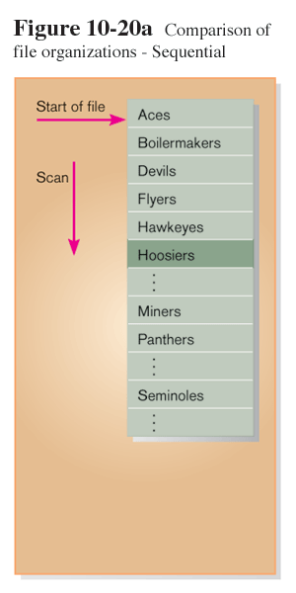
Sequential File Organization
A file organization in which rows are stored in a sequence according to primary key value

Slide 51
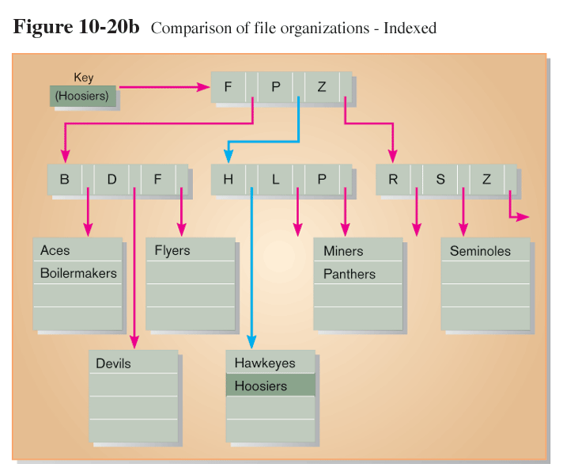
Indexed File Organization
A file organization in which rows are stored either sequentially or nonsequentially and an index is created that allows software to locate individual rows
Index: A table used to determine the location of rows in a file that satisfy some condition

Slide 52
Guidelines for Choosing Indexes
Specify a unique index for the primary key of each table.
Specify an index for foreign keys.
Specify an index for nonkey fields that are referenced in qualification, sorting and grouping commands for the purpose of retrieving data.

Slide 53
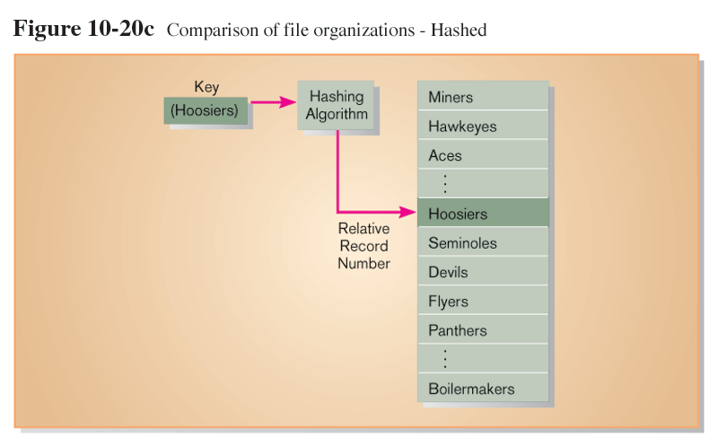
Hashed File Organization
A file organization in which the address for each row is determined using an algorithm

Slide 54
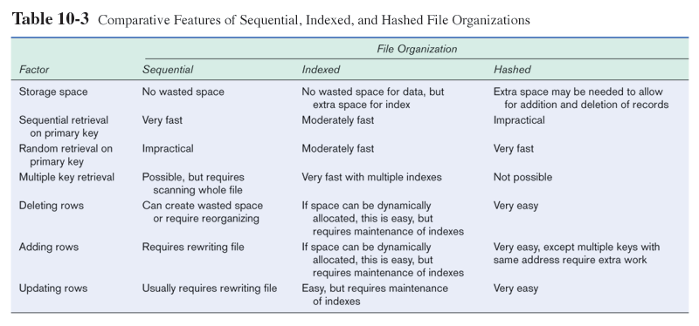

Slide 55
Summary
In this chapter you learned how to:
Define key database design terms.
Explain the role of database design in the IS development process.
Transform E-R or class diagrams into normalized relations
Merge normalized relations from separate user views into a consolidated set of well-structured relations.
Choose storage formats for fields.
Translate well-structured relations into database tables.
Explain when to use different types of file organizations.
Describe the purpose and appropriate use of indexes.

